Slide 1
Statistics B
Chapter 1: Introduction to Data
Shizhe Peng
School of Economics and Management
Changsha University of Science and Technology

Slide 2

What is Statistics?

Slide 3
Case Study:
Treating Chronic Fatigue Syndrome
Notes:
/ˈsɪndrəʊm/ 综合征

Slide 4
Treating Chronic Fatigue Syndrome
Objective. Evaluate the effectiveness of cognitive-behavior therapy for chronic fatigue syndrome.
Participant pool. 142 patients who were recruited by primary care physicians and consultants to a hospital clinic specializing in chronic fatigue syndrome.
Actual participants. Only 60 of the 142 referred patients entered the study. Some were excluded because they didn't meet the diagnostic criteria, some had other health issues, and some refused to be a part of the study.

Slide 5
Study Design
Patients randomly assigned to treatment and control groups, 30 patients in each group:
Treatment: Cognitive behavior therapy -- collaborative, educative, and with a behavioral emphasis. Patients were shown on how activity could be increased steadily and safely without exacerbating symptoms.
Control: Relaxation -- No advice was given about how activity could be increased. Instead progressive muscle relaxation, visualization, and rapid relaxation skills were taught.

Slide 6
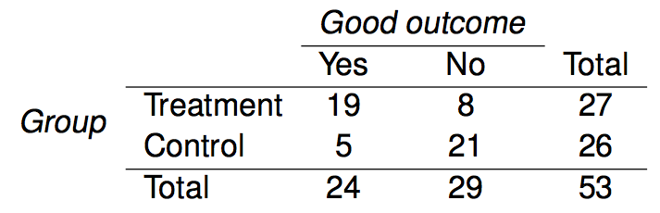
Results
The table below shows the distribution of patients with good outcomes at 6-month follow-up. Note that 7 patients dropped out of the study: 3 from the treatment and 4 from the control group.
Proportion with good outcomes in treatment group
19/27 ≈ 0.70 → 70%
Proportion with good outcomes in control group
5/26 ≈ 0.19 → 19%
Notes:
intersection

Slide 7
Understanding the results
Do the data show a "real" difference between the groups?
Suppose you flip a coin 100 times. While the chance a coin lands heads in any given coin flip is 50%, we probably won't observe exactly 50 heads. This type of fluctuation is part of almost any type of data generating process.
The observed difference between the two groups (70 - 19 = 51%) may be real, or may be due to natural variation.
Since the difference is quite large, it is more believable that the difference is real.
We use statistical tools to determine if the difference is so large that we should reject the notion that it was due to chance.
Notes:
additional

Slide 8
Generalizing the results
Are the results of this study generalizable to all patients with chronic fatigue syndrome?
These patients had specific characteristics and volunteered to be a part of this study, therefore they may not be representative of all patients with chronic fatigue syndrome. While we cannot immediately generalize the results to all patients, this first study is encouraging. The method works for patients with some narrow set of characteristics, and that gives hope that it will work, at least to some degree, with other patients

Slide 9
Data Basics

Slide 10
Classroom survey
A survey was conducted on students in an introductory statistics course. Below are a few of the questions on the survey, and the corresponding variables the data from the responses were stored in:
gender: What is your gender?
intro_extra: Are you an introvert or an extrovert?
sleep: How many hours do you sleep at night, on average?
bedtime: What time do you usually go to bed?
countries: How many countries have you visited?
dread: On a scale of 1-5, how much do you dread being here?

Slide 11
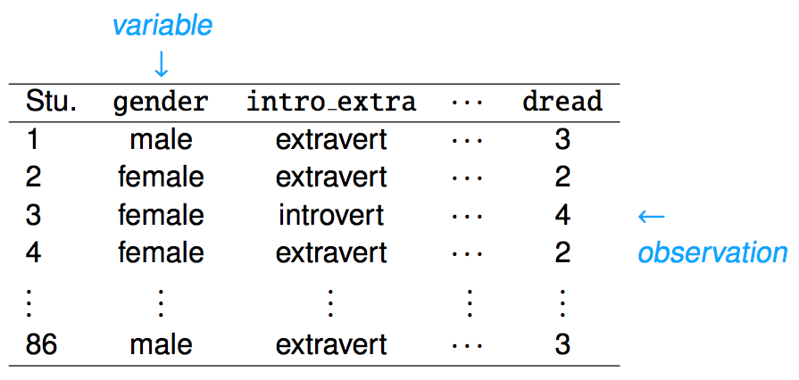
Data matrix
Data collected on students in a statistics class on a variety of variables:
Notes:
how to add another case

Slide 12
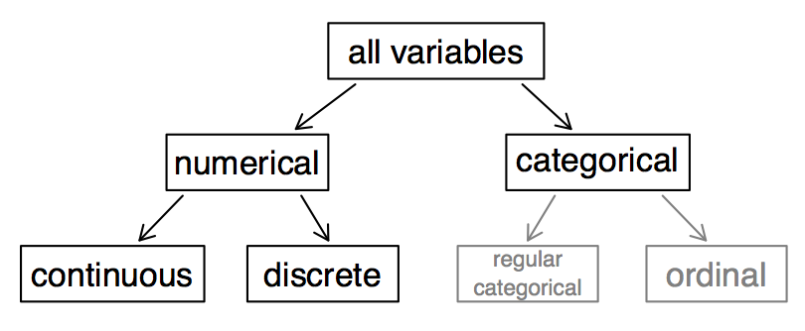
Types of variables
Notes:
hierarchy
add or subtract
even if we number a categorical variable, their sum and difference would have no clear meaning

Slide 13
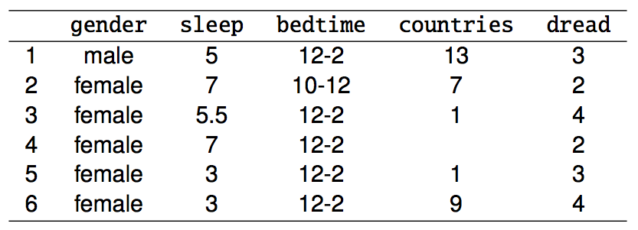
Types of variables (cont.)
gender: categorical
sleep: numerical, continuous
bedtime: categorical, ordinal
countries: numerical, discrete
dread: categorical, ordinal - could also be used as numerical

Slide 14
Practice
What type of variable is a telephone area code?
(a) numerical, continuous
(b) numerical, discrete
(c) categorical
(d) categorical, ordinal

Slide 15
Practice
What type of variable is a telephone area code?
(a) numerical, continuous
(b) numerical, discrete
(c) categorical
(d) categorical, ordinal

Slide 16
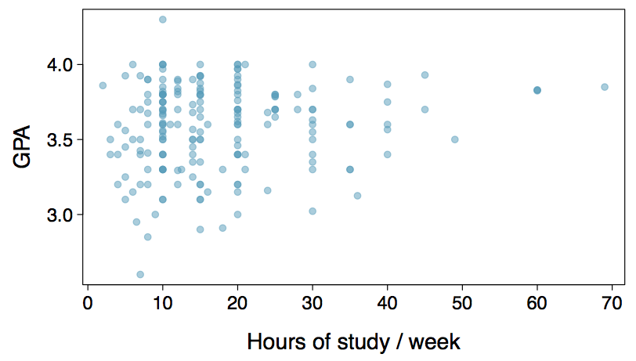
Scatter Plots and Relationships among variables
Does there appear to be a relationship between the hours of study per week and the GPA of a student?
Can you spot anything unusual about any of the data points?
There is one student with GPA > 4.0, this is likely a data error.
Notes:
each point in the scatterplot

Slide 17
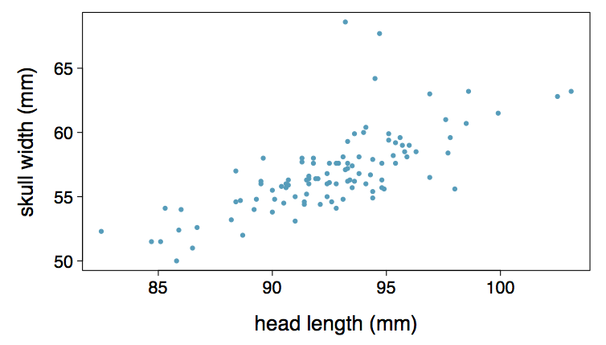
Practice
Based on the scatterplot on the right, which of the following statements is correct about the head and skull lengths of possums?
(a) There is no relationship between head length and skull width,
i.e. the variables are independent.
(b) Head length and skull width are positively associated.
(c) Skull width and head length are negatively associated.
(d) A longer head causes the skull to be wider.
(e) A wider skull causes the head to be longer.

Slide 18
Practice
Based on the scatterplot on the right, which of the following statements is correct about the head and skull lengths of possums?
(a) There is no relationship between head length and skull width,
i.e. the variables are independent.
(b) Head length and skull width are positively associated.
(c) Skull width and head length are negatively associated.
(d) A longer head causes the skull to be wider.
(e) A wider skull causes the head to be longer.

Slide 19
Associated vs. independent
When two variables show some connection with one another, they are called associated variables.
  Associated variables can also be called dependent variables and vice-versa.
If two variables are not associated, i.e. there is no evident connection between the two, then they are said to be independent.

Slide 20
Observational studies and sampling strategies
Notes:
the data are reliable

Slide 21
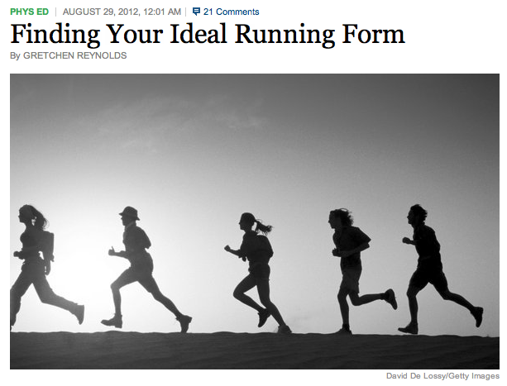
Populations and Samples
Research Question: Can people become better, more efficient runners on their own, merely by running?
Population of Interest: All people
http://well.blogs.nytimes.com/2012/08/29/finding-your-ideal-running-form
Sample: Group of adult women who recently joined a running group
Population to which results can be generalized: Adult women, if the data are randomly sampled
Notes:
a subset and a small fraction

Slide 22
Anecdotal evidence and early smoking research
Anti-smoking research started in the 1930s and 1940s when cigarette smoking became increasingly popular. While some smokers seemed to be sensitive to cigarette smoke, others were completely unaffected.
Anti-smoking research was faced with resistance based on anecdotal evidence such as "My uncle smokes three packs a day and he's in perfectly good health", evidence based on a limited sample size that might not be representative of the population.
It was concluded that "smoking is a complex human behavior, by its nature difficult to study, confounded by human variability."
In time researchers were able to examine larger samples of cases (smokers), and trends showing that smoking has negative health impacts became much clearer.

Slide 23
Census
Wouldn't it be better to just include everyone and "sample" the entire population?
  This is called a census.
There are problems with taking a census:
  It can be difficult to complete a census: there always seem to be some individuals who are hard to locate or hard to measure. And these difficult-to-find people may have certain characteristics that distinguish them from the rest of the population.
  Populations rarely stand still. Even if you could take a census, the population changes constantly, so it's never possible to get a perfect measure.
  Taking a census may be more complex than sampling.

Slide 24
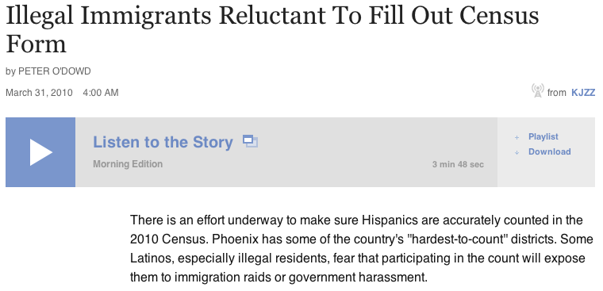

Slide 25
Exploratory analysis to inference
Sampling is natural.
Think about sampling something you are cooking - you taste (examine) a small part of what you're cooking to get an idea about the dish as a whole.
When you taste a spoonful of soup and decide the spoonful you tasted isn't salty enough, that's exploratory analysis.
If you generalize and conclude that your entire soup needs salt, that's an inference.
For your inference to be valid, the spoonful you tasted (the sample) needs to be representative of the entire pot (the population).
  If your spoonful comes only from the surface and the salt is collected at the bottom of the pot, what you tasted is probably not representative of the whole pot.
  If you first stir the soup thoroughly before you taste, your spoonful will more likely be representative of the whole pot.

Slide 26
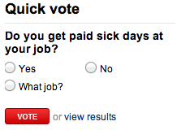
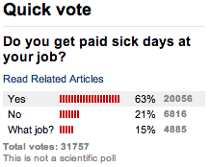
Sampling bias
Non-response: If only a small fraction of the randomly sampled people choose to respond to a survey, the sample may no longer be representative of the population.
Voluntary response: Occurs when the sample consists of people who volunteer to respond because they have strong opinions on the issue. Such a sample will also not be representative of the population.
Convenience sample: Individuals who are easily accessible are more likely to be included in the sample.
Notes:
draw a representative sample and avoid bias

Slide 27
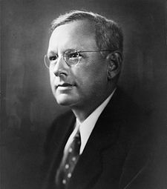
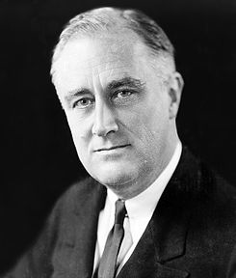
Sampling bias example:
Landon vs. FDR
A historical example of a biased sample yielding misleading results
In 1936, Landon sought the Republican presidential nomination opposing the re-election of FDR.

Slide 28

The Literary Digest Poll
The Literary Digest polled about 10 million Americans, and got responses from about 2.4 million.
The poll showed that Landon would likely be the overwhelming winner and FDR would get only 43% of the votes.
Election result: FDR won, with 62% of the votes.
The magazine was completely discredited because of the poll, and was soon discontinued.

Slide 29
The Literary Digest Poll -
what went wrong?
The magazine had surveyed
  its own readers,
  registered automobile owners, and
  registered telephone users.
These groups had incomes well above the national average of the day (remember, this is Great Depression era) which resulted in lists of voters far more likely to support Republicans than a truly typical voter of the time, i.e. the sample was not representative of the American population at the time.

Slide 30
Large samples are preferable, but...
The Literary Digest election poll was based on a sample size of 2.4 million, which is huge, but since the sample was biased, the sample did not yield an accurate prediction.
Back to the soup analogy: If the soup is not well stirred, it doesn't matter how large a spoon you have, it will still not taste right. If the soup is well stirred, a small spoon will suffice to test the soup.

Slide 31
Practice
A school district is considering whether it will no longer allow high school students to park at school after two recent accidents where students were severely injured. As a first step, they survey parents by mail, asking them whether or not the parents would object to this policy change. Of 6,000 surveys that go out, 1,200 are returned. Of these 1,200 surveys that were completed, 960 agreed with the policy change and 240 disagreed. Which of the following statements are true?
Some of the mailings may have never reached the parents.
The school district has strong support from parents to move forward with the policy approval.
It is possible that majority of the parents of high school students disagree with the policy change.
The survey results are unlikely to be biased because all parents were mailed a survey.
(a) Only I (b) I and II (c) I and III (d) III and IV (e) Only IV

Slide 32
Practice
A school district is considering whether it will no longer allow high school students to park at school after two recent accidents where students were severely injured. As a first step, they survey parents by mail, asking them whether or not the parents would object to this policy change. Of 6,000 surveys that go out, 1,200 are returned. Of these 1,200 surveys that were completed, 960 agreed with the policy change and 240 disagreed. Which of the following statements are true?
Some of the mailings may have never reached the parents.
The school district has strong support from parents to move forward with the policy approval.
It is possible that majority of the parents of high school students disagree with the policy change.
The survey results are unlikely to be biased because all parents were mailed a survey.
(a) Only I (b) I and II (c) I and III (d) III and IV (e) Only IV

Slide 33
Observational studies
Researchers collect data in a way that does not directly interfere with how the data arise and only by monitoring what occurs.
Results of an observational study can generally be used to establish an association between the explanatory (Xs) and response variables (Y).
Association does not imply causation. For example, sunscreen use and skin cancer.
When researchers want to investigate the possibility of a causal connection, they conduct an experiment.

Slide 34
Obtaining good samples
Almost all statistical methods are based on the notion of implied randomness.
If observational data are not collected in a random framework from a population, these statistical methods – the estimates and errors associated with the estimates – are not reliable.
Most commonly used random sampling techniques are simple, stratified, and cluster sampling.

Slide 35
Prospective vs.
Retrospective Studies
A prospective study identifies individuals and collects information as events unfold.
Example: The Nurses Health Study has been recruiting registered nurses and then collecting data from them using questionnaires since 1976.
Retrospective studies collect data after events have taken place.
Example: Researchers reviewing past events in medical records.

Slide 36
Obtaining Good Samples
Almost all statistical methods are based on the notion of implied randomness.
If observational data are not collected in a random framework from a population, these statistical methods -- the estimates and errors associated with the estimates -- are not reliable.
Most commonly used random sampling techniques are simple, stratified, and cluster sampling.

Slide 37
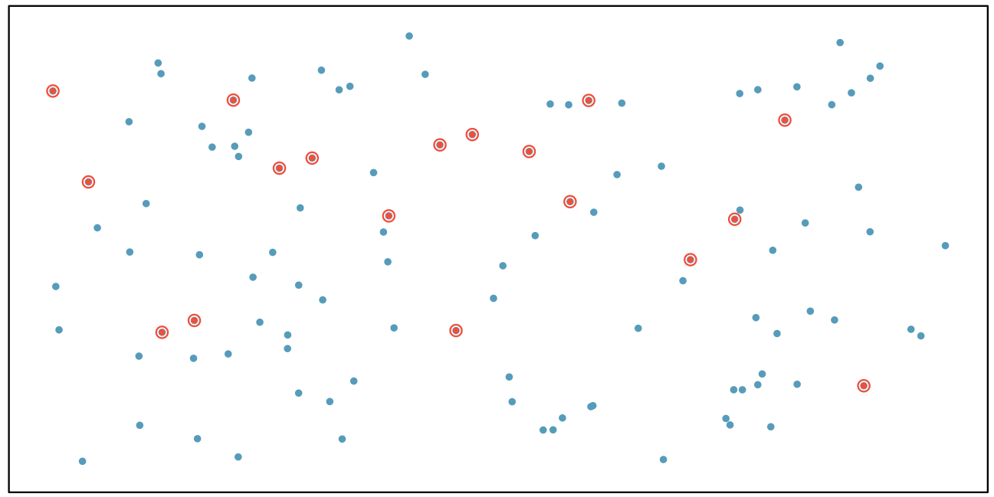
Simple Random Sample
Randomly select cases from the population, where there is no implied connection between the points that are selected.
Caution must be exercised if the non-response is high.
A convenience sample, where individuals who are easily accessible are more likely to be included in the sample, is generally a bad basis for making conclusions about the population
Notes:
slips of paper, shake the bucket around, draw out slips

Slide 38
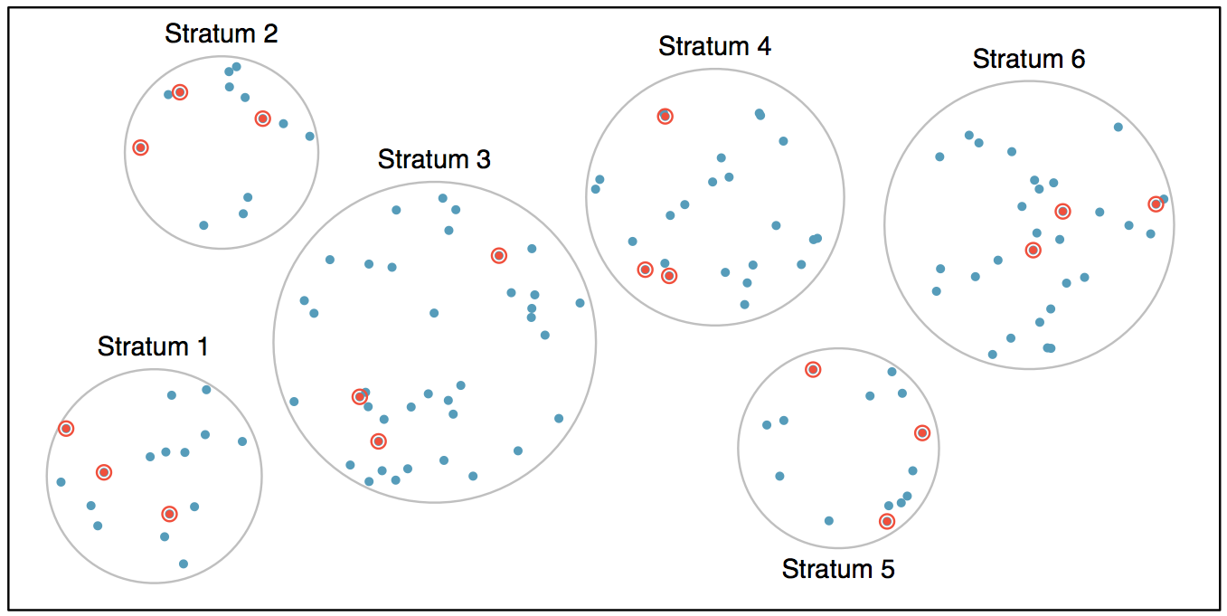
Stratified Sample
Strata are made up of similar observations. We take a simple random sample from each stratum.
Notes:
a divide and conquer approach

Slide 39
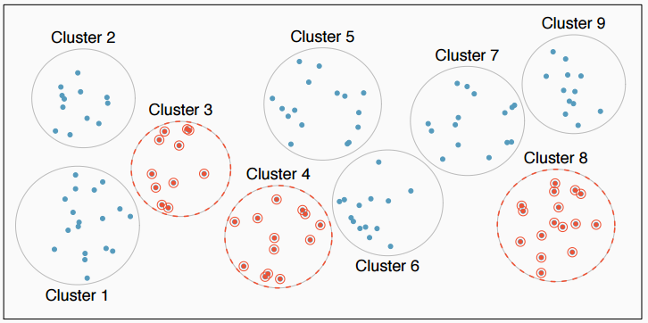
Cluster Sample
Clusters are usually not made up of homogeneous observations. We take a simple random sample of clusters, and then sample all observations in that cluster. Usually preferred for economical reasons.

Slide 40
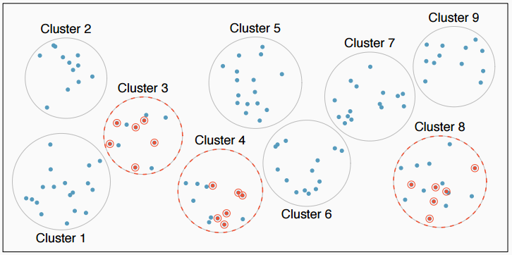
Multistage Sample
Clusters are usually not made up of homogeneous observations. We take a simple random sample of clusters, and then take a simple random sample of observations from the sampled clusters

Slide 41
Practice
A city council has requested a household survey be conducted in a suburban area of their city. The area is broken into many distinct and unique neighborhoods, some including large homes, some with only apartments. Which approach would likely be the least effective?
(a) Simple random sampling
(b) Cluster sampling
(c) Stratified sampling
(d) Blocked sampling

Slide 42
Practice
A city council has requested a household survey be conducted in a suburban area of their city. The area is broken into many distinct and unique neighborhoods, some including large homes, some with only apartments. Which approach would likely be the least effective?
(a) Simple random sampling
(b) Cluster sampling
(c) Stratified sampling
(d) Blocked sampling

Slide 43
Experiments

Slide 44
Principles of experimental design
Control: Compare treatment of interest to a control group.
Randomize: Randomly assign subjects to treatments, and randomly sample from the population whenever possible.
Replicate: Within a study, replicate by collecting a sufficiently large sample. Or replicate the entire study.
Block: If there are variables that are known or suspected to affect the response variable, first group subjects into blocks based on these variables, and then randomize cases within each block to treatment groups.

Slide 45
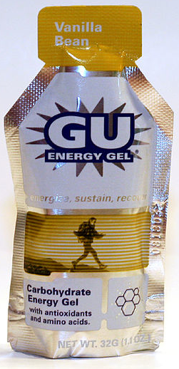
More on Blocking
We would like to design an experiment to investigate if energy gels makes you run faster:
Treatment: energy gel
Control: no energy gel (or a placebo to circumvent psychological effects, often a slight but real improvement)
It is suspected that energy gels might affect pro and amateur athletes differently, therefore we block for pro status:
Divide the sample to pro and amateur
Randomly assign pro athletes to treatment and control groups
Randomly assign amateur athletes to treatment and control groups
Pro/amateur status is equally represented in the resulting treatment and control groups
Why is this important? Can you think of other variables to block for?
Notes:
uninformed
is said to be blind

Slide 46
Practice
A study is designed to test the effect of light level and noise level on exam performance of students. The researcher also believes that light and noise levels might have different effects on males and females, so wants to make sure both genders are equally represented in each group. Which of the below is correct?
There are 3 explanatory variables (light, noise, gender) and 1 response variable (exam performance)
There are 2 explanatory variables (light and noise), 1 blocking variable (gender), and 1 response variable (exam performance)
There is 1 explanatory variable (gender) and 3 response variables (light, noise, exam performance)
There are 2 blocking variables (light and noise), 1 explanatory variable (gender), and 1 response variable (exam performance)

Slide 47
Practice
A study is designed to test the effect of light level and noise level on exam performance of students. The researcher also believes that light and noise levels might have different effects on males and females, so wants to make sure both genders are equally represented in each group. Which of the below is correct?
There are 3 explanatory variables (light, noise, gender) and 1 response variable (exam performance)
There are 2 explanatory variables (light and noise), 1 blocking variable (gender), and 1 response variable (exam performance)
There is 1 explanatory variable (gender) and 3 response variables (light, noise, exam performance)
There are 2 blocking variables (light and noise), 1 explanatory variable (gender), and 1 response variable (exam performance)

Slide 48
Difference Between Blocking and Explanatory Variables
Factors are conditions we can impose on the experimental units.
Blocking variables are characteristics that the experimental units come with, that we would like to control for.
Blocking is like stratifying, except used in experimental settings when randomly assigning, as opposed to when sampling.

Slide 49
More Experimental Design Terminology...
Placebo: fake treatment, often used as the control group for medical studies
Placebo effect: experimental units showing improvement simply because they believe they are receiving a special treatment
Blinding: when experimental units do not know whether they are in the control or treatment group
Double-blind: when both the experimental units and the researchers who interact with the patients do not know who is in the control and who is in the treatment group

Slide 50
Practice
What is the main difference between observational studies and experiments?
Experiments take place in a lab while observational studies do not need to.
In an observational study we only look at what happened in the past.
Most experiments use random assignment while observational studies do not.
Observational studies are completely useless since no causal inference can be made based on their findings.

Slide 51
Practice
What is the main difference between observational studies and experiments?
Experiments take place in a lab while observational studies do not need to.
In an observational study we only look at what happened in the past.
Most experiments use random assignment while observational studies do not.
Observational studies are completely useless since no causal inference can be made based on their findings.

Slide 52
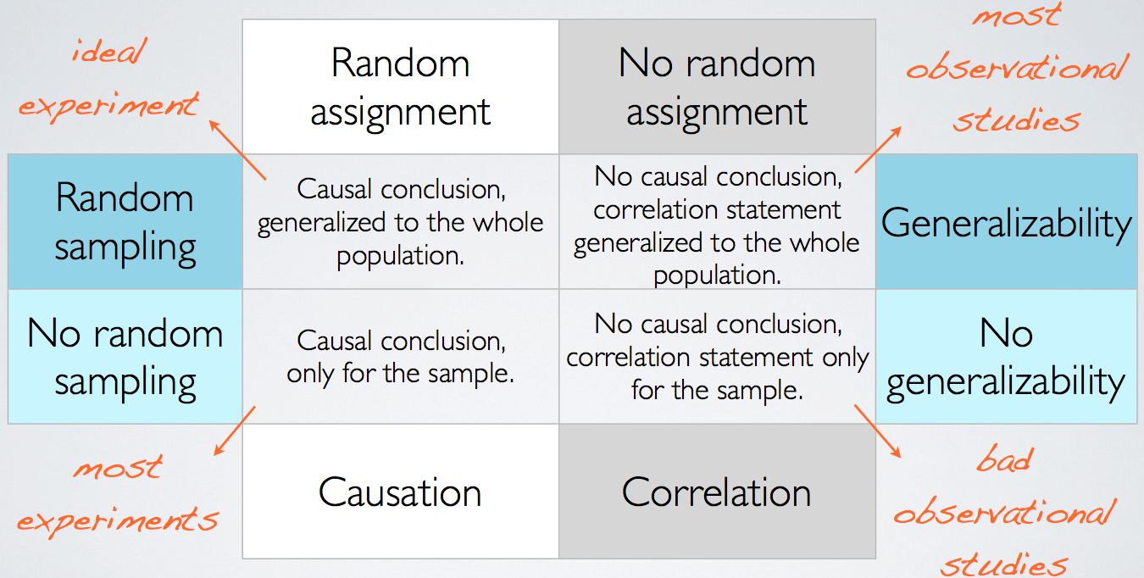
Random Assignment
vs. Random Sampling

